Slide 1
Full-Stack Web Development
Lecture 4: Handling Authentication
Ashley Williams
Ashley.Williams@mmu.ac.uk
Notes:
What is authentication?
Authentication is the process of determining whether someone or something is, in fact, who or what it says it is. Authentication technology provides access control for systems by checking to see if a user's credentials match the credentials in a database of authorized users or in a data authentication server. In doing this, authentication assures secure systems, secure processes and enterprise information security.
https://www.techtarget.com/searchsecurity/definition/authentication
Why do we authenticate?
Authentication enables organizations to keep their networks secure by permitting only authenticated users or processes to gain access to their protected resources. This may include computer systems, networks, databases, websites and other network-based applications or services.
https://www.techtarget.com/searchsecurity/definition/authentication
REST APIs and tokens
plain text passwords
- signing up
- logging in
- problems: anyone with access can see (hackers, employee's, companies)
We could try to hide the password with encryption.
Before we start talking about hashing, we first need to get a better understanding of encryption in general. Here’s how it works: you pass some text — also known as a “string” in programming jargon — as an input to an algorithm. This algorithm processes each character of the string in some way. Let’s imagine we have an algorithm that adds the letter “a” after each character:
password → paaasasawaoarada
Alternatively, we could use an algorithm that replaces each letter with the one that follows it alphabetically. “A” would turn into “B,” “D” into “E,” and so on:
password → qbttxpse
The problem with such algorithms is that they’re quite basic, meaning that they’re relatively easy to decipher. As such, these kinds of traditional encryption algorithms are no good for storing passwords in the modern world.
Hashing
Hashing, or hash algorithms, work differently. They take some text as an input, perform some mathematical operations with it, and produce a new encrypted text as a result. This result is referred to as a hash value, hash code, or simply a hash. The trick here is that, regardless of the length of the incoming text, the resulting strings always have the same length, and it’s virtually impossible to decrypt the original text from them.
- mathematical one way functions to convert into a hash of the original
password → 5F4DCC3B5AA765D61D8327DEB882CF99
But what about logging in?
password != 5F4DCC3B5AA765D61D8327DEB882CF99
well we can hash the login password too and then compare the hash values:
5F4DCC3B5AA765D61D8327DEB882CF99 == 5F4DCC3B5AA765D61D8327DEB882CF99
Does this mean that hashing is the answer to all our problems?
Not exactly. You see, if we have access to a database with all the hashed passwords, it’s highly likely that we’d be able to crack a significant chunk of them. This is made possible by the fact that if you input a certain password to a hashing algorithm, it will always return the same hash. This means that if two people have the same password for the website in question, they’ll both have the same hashed password in the database.
Let’s say that they find several thousand instances of the following hash:
D8578EDF8458CE06FBC5BB76A58C5CA4
The hacker knows this must be a commonly-used password, so they try hashing some simple passwords:
passwordv → 5F4DCC3B5AA765D61D8327DEB882CF99
no match
qwerty123 → 3FC0A7ACF087F549AC2B266BAF94B8B1
no match
qwerty → D8578EDF8458CE06FBC5BB76A58C5CA4
it’s a match!
The hacker suspected that some users had qwerty as their password, hashed this password, then matched it to the hash in the database.
We can take this a step further. The most common passwords consist of simple combinations of letters, pet names, or birthdays. What if we make a list of the most popular passwords in the US and their corresponding hashes? We’ll have a list that looks something like this:
password → 5F4DCC3B5AA765D61D8327DEB882CF99
password123 → 482C811DA5D5B4BC6D497FFA98491E38
qwerty → D8578EDF8458CE06FBC5BB76A58C5CA4
whiskers2013 → 110B4461FA1F51CA4973ACD36C691880
snowball → 3B9787927ECBF1B5A270CE1FF8566872
qwerty123 → 3FC0A7ACF087F549AC2B266BAF94B8B1
qwertyqwerty → 12478E7AD0E39AA9C35BE4B9A694BA9B
12345 → 827CCB0EEA8A706C4C34A16891F84E7B
123456 → E10ADC3949BA59ABBE56E057F20F883E
1234567 → FCEA920F7412B5DA7BE0CF42B8C93759
123456789 → 25F9E794323B453885F5181F1B624D0B
Now, let’s add all the birth dates from the 1st January of 1948 to the 31st December of 1978 (this is the age group most likely to choose their birthday as their password):
01011948 → 2202954E3ED7E98E4B4843DF26B2B7DB
01021948 → 8DF15B6CC8FE0382CE3FD7485224EEB7
12311978 → F3E05C17691522096D554408F1B6ABFB
Let’s say we have tens of thousands of passwords in our list. We can create a program for making hash tables to avoid building them manually. What’s more, we can download such a table from hacker forums.
This is called a dictionary attack
https://medium.com/practicum-by-yandex/how-to-protect-your-passwords-the-dangers-of-plain-text-storage-b8d63f40c211
Salting
In cryptography, the expression refers to adding random data to the input of a hash function to guarantee a unique output, the hash, even when the inputs are the same
password + random_salt = 8DF15B6CC8FE0382CE3FD7485224EEB7
password + random_salt2 = F3E05C17691522096D554408F1B6ABFB
The hashes are different, so can't be beat by a dictionary attack.
In practice, we store the salt in cleartext along with the hash in our database. We would store the salt, the hashed password, and the username together so that when the user logs in, we can lookup the username, append the salt to the provided password, hash it, and then verify if the stored hash matches the computed hash.
https://auth0.com/blog/adding-salt-to-hashing-a-better-way-to-store-passwords/
Note: doesn't need to be password + salt
8DF15B6CC8FE0382CE3FD7485224EEB7saltvalue
saltvalue8DF15B6CC8FE0382CE3FD7485224EEB7
8sDaFl1t5vBa6lCuCe8FE0382CE3FD7485224EEB7
could all be stored in one field - hackers need to know the policy for finding the salt
Sprinkling in some pepper
A pepper is similar to a salt — a random bit of data added to the password before it’s hashed through an algorithm. But unlike a salt, it’s not kept in the database along with the hash value. Instead, it’s usually hardcoded into the website’s source code.
The biggest advantage of a pepper is the fact that it’s not kept in the database. So in the case of a data breach, even with access to all the hashed passwords, the attacker would still need to brute-force the database.
However, since the pepper is hardcoded, it’s usually the same bit of data for each password, and it can’t be changed. So following a data breach, the pepper might be more trouble than it’s worth. Additionally, the majority of advanced hashing algorithms are intended to be used with salts. So the implementation of peppers might be a bit impractical.
https://nordpass.com/blog/pepper-password/#:~:text=A%20pepper%20is%20similar%20to,into%20the%20website's%20source%20code.
implementing
POST /user
- creating a salt
- hasing the pass
- storing in the database
POST /login
- get the salt and hash out of the db
- use the salt to hash the incoming password
- compare with the db hash
- if both are the same, generate a random token ans store in session token
POST /logout
- delete the token
middleware
Middleware functions are functions that have access to the request object (req), the response object (res), and the next middleware function in the application’s request-response cycle. The next middleware function is commonly denoted by a variable named next.
Middleware functions can perform the following tasks:
Execute any code.
Make changes to the request and the response objects.
End the request-response cycle.
Call the next middleware function in the stack.
If the current middleware function does not end the request-response cycle, it must call next() to pass control to the next middleware function. Otherwise, the request will be left hanging.
https://expressjs.com/en/guide/using-middleware.html
- using middleware to check that token is valid
- function, adding to the route to check logged in
A better way of doing things?
The safest way to handle a password is to not handle a password
log in with Google, Facebook, GitHub, Twitch etc
PassportJS
Strategies

Slide 2
Learning Objectives
To understand what authentication is and why it's important
To understand how to implement authentication in our Node/Express applications
To learn about how authentication works in the real world

Slide 3
Unit Overview
# | W/C | Lecture | Lab
1 | 03/10/2022 | Introduction to Full-Stack | Recap/RESTful APIs
2 | 10/10/2022 | Introduction to NodeJS/ExpressJS | Getting started with NodeJS/ExpressJS
3 | 17/10/2022 | Interacting with Databases | Interacting with Databases
4 | 24/10/2022 | Handling Authentication | Handling Authentication
5 | 31/10/2022 | Version Control | Assignment Support: Backend
6 | 07/11/2022 | API Security and Scaling | Assignment Support: Backend
7 | 14/11/2022 | Introduction to VueJS | VueJS Basics
8 | 21/11/2022 | Style, Layout, and Navigation | Layout and Navigation
9 | 28/11/2022 | Networking | Handling API requests
10 | 05/12/2022 | Structuring and Refactoring | Assignment Support: Front-end
11 | 12/12/2022 | Code Quality | Assignment Support: Front-end

Slide 4
What is authentication?

Slide 5
What is authentication?
“the process of determining whether someone or something is, in fact, who or what it says it is.”
“Authentication technology provides access control for systems by checking to see if a user's credentials match the credentials in a database of authorized users or in a data authentication server. In doing this, authentication assures secure systems, secure processes and enterprise information security.”
Why do we authenticate?
“Authentication enables organizations to keep their networks secure by permitting only authenticated users or processes to gain access to their protected resources. This may include computer systems, networks, databases, websites and other network-based applications or services.”
https://www.techtarget.com/searchsecurity/definition/authentication

Slide 6
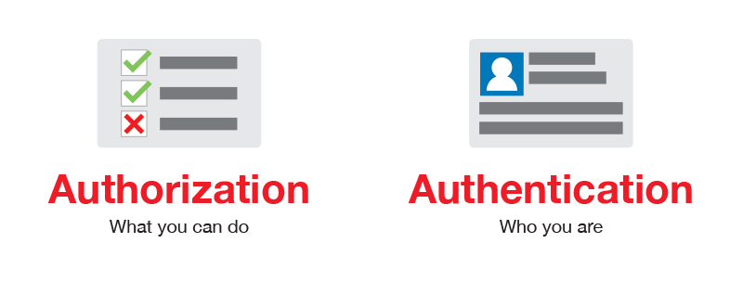
Not to be confused with Authorisation
“When an entity proves a right to access. In other words, Authorization proves you have the right to make a request.”
“Consider the following - You have a working key card that allows you to open only some doors in the work area, but not all of them.”
https://blog.restcase.com/4-most-used-rest-api-authentication-methods/

Slide 7
Access Tokens
Access tokens are used to grant access to an application to an API
The application receives a token from the API after successfully authenticating
The application then passes that token as a credential when trying to access resources that are protected
Authorisation systems can also be used to limit the scope of what particular tokens/users can do
In the assignment:
The user sends their email and password to the login endpoint
The server checks the email and password is correct. If so, creates a token and stores it in the DB
The user then tries to access a protected endpoint, sending the token as a header (e.g., X-Authorization)
The server checks the token against the value in the DB. If it exists, then will let the user access the endpoint.
When the user logs out, the token is simply deleted from the DB. This blocks subsequent requests.

Slide 8
Sign up and login
POST /user
{
“first_name”:”Ash”,
“last_name”:”Williams”,
“email”:”ash@mmu.ac.uk”,
“password”: “JSRox”
}
User_id | Email | Password | …
105 | ash@mmu.ac.uk | JSRox | …
Do the passwords match?
Problems with this approach?
POST /login
{
“email”:”ash@mmu.ac.uk”,
“password”: “JSRox”
}

Slide 9
Sign up and login
POST /user
{
“first_name”:”Ash”,
“last_name”:”Williams”,
“email”:”ash@mmu.ac.uk”,
“password”: “JSRox”
}
User_id | Email | Password | …
105 | ash@mmu.ac.uk | JSRox | …
Do the passwords match?
Problems with this approach?
Anyone with access can see the passwords (hackers, employee’s, companies)
POST /login
{
“email”:”ash@mmu.ac.uk”,
“password”: “JSRox”
}

Slide 10
Encryption 101
We can hide passwords with encryption
  Password string → Some algorithm → Encrypted password
Let’s imagine the algorithm adds an “a” after each character in the password:
  “password” → paaasasawaoarada
Alternatively, we could replace each character with the next in the alphabet (i.e., Caesar cipher)
  password → qbttxpse
What’s wrong?
  They algorithms here are quite basic, and relatively easy to decipher. Hence, no good for storing passwords in the modern world
https://medium.com/practicum-by-yandex/how-to-protect-your-passwords-the-dangers-of-plain-text-storage-b8d63f40c211

Slide 11


Hashing Passwords
Hash algorithms use mathematical one-way functions to produce hash values
  Regardless of the length of the password, the hash will always be the same length
  password → 5F4DCC3B5AA765D61D8327DEB882CF99
But what about logging in?
  password != 5F4DCC3B5AA765D61D8327DEB882CF99
Well, we hash the login password the same way and then compare the hash values:
  5F4DCC3B5AA765D61D8327DEB882CF99 === 5F4DCC3B5AA765D61D8327DEB882CF99

Slide 12
Is hashing the answer to all of our problems?
Not really – imagine we had access to a database with all of the hashed passwords, we would probably be able to crack a large number of them..
Why?
  An input will always produce the same hash – if people have the same password then they’ll also have the same hashed password
  Take this hash: D8578EDF8458CE06FBC5BB76A58C5CA4
  Let’s try cracking using some commonly used passwords:
    passwordv → 5F4DCC3B5AA765D61D8327DEB882CF99
    qwerty123 → 3FC0A7ACF087F549AC2B266BAF94B8B1
    qwerty → D8578EDF8458CE06FBC5BB76A58C5CA4

Slide 13
Let’s create a list of commonly used passwords…
Simple combination of letters, pet names, birthdays – we can make a list of the most popular and their hashes
People born between 1st January of 1948 to the 31st December of 1978 are the age group that are most likely to use their birthday
This list can be 1000’s long, then we can write a programme to loop through them
Lists like this exist on the internet
What’s the name of this attack?
password → 5F4DCC3B5AA765D61D8327DEB882CF99
password123 → 482C811DA5D5B4BC6D497FFA98491E38
qwerty → D8578EDF8458CE06FBC5BB76A58C5CA4
whiskers2013 → 110B4461FA1F51CA4973ACD36C691880
snowball → 3B9787927ECBF1B5A270CE1FF8566872
qwerty123 → 3FC0A7ACF087F549AC2B266BAF94B8B1
qwertyqwerty → 12478E7AD0E39AA9C35BE4B9A694BA9B
12345 → 827CCB0EEA8A706C4C34A16891F84E7B
123456 → E10ADC3949BA59ABBE56E057F20F883E
1234567 → FCEA920F7412B5DA7BE0CF42B8C93759
123456789 → 25F9E794323B453885F5181F1B624D0B
01011948 → 2202954E3ED7E98E4B4843DF26B2B7DB
01021948 → 8DF15B6CC8FE0382CE3FD7485224EEB7
12311978 → F3E05C17691522096D554408F1B6ABFB
https://medium.com/practicum-by-yandex/how-to-protect-your-passwords-the-dangers-of-plain-text-storage-b8d63f40c211
Notes:
Dictionary attack

Slide 14
Salting
The act of adding random data to the input of the hast function to ensure the output is unique – even when the inputs are the same:
  password + random_salt = 8DF15B6CC8FE0382CE3FD7485224EEB7
  password + random_salt2 = F3E05C17691522096D554408F1B6ABFB
  The hashes are different, so can’t be bear by a dictionary attack
https://auth0.com/blog/adding-salt-to-hashing-a-better-way-to-store-passwords/

Slide 15
Salting II
{
“user”: “ash”,
“pass”: “hello123”
}
id | user | hash | salt | …
105 | ash | 8DF15B6… | F3E05C… | …
We store the salt in cleartext, along with the hash in our database.
  We store the salt, hashed password, and username together
  When a user logs in, we lookup the username, add the salt to the provided password, hash it, then compare the calculated hash with the hash in the database
https://auth0.com/blog/adding-salt-to-hashing-a-better-way-to-store-passwords/
Step 1: Incoming pass + salt = hash
Step 2: Does hash === 8DF15B6…?

Slide 16
Salting III
Note: it doesn’t need to be password + salt
  8DF15B6CC8FE0382CE3FD7485224EEB7saltvalue
  saltvalue8DF15B6CC8FE0382CE3FD7485224EEB7
  8sDaFl1t5vBa6lCuCe8FE0382CE3FD7485224EEB7
Could all be stored in one field - hackers need to know the policy for finding the salt

Slide 17
Sprinkling in some pepper
A pepper is similar to a salt – a random string of data which is added to a password before it is hashed
However, it is not kept in the database, it is hardcoded into the applications source code
In the event of a data breach, even with all of the hashes, the attacker still needs to brute-force the database
However, since it is hardcoded, it cannot be changed. Therefore, following a breach, it may be more trouble than it is worth!
Additionally, the majority of advanced hashing algorithms are intended to be used with salts, so implementing peppers can be impractical
https://nordpass.com/blog/pepper-password/#:~:text=A%20pepper%20is%20similar%20to,into%20the%20website's%20source%20code.

Slide 18
Assignment Authentication Workflow
A user creates an account (POST /user)
  A salt is auto generated and their password is hashed.
  The DB stores the email, salt, hash, and other user info
The user logs in (POST /user)
  The DB email, hash and salt is retrieved
  The incoming password is hashed using the salt from the DB
  The two hashes are compared
  A token is generated and stored in the users table
The user requests an authenticated endpoint (e.g., POST /article)
  The token is sent as an X-Authorization header
  The token is checked against the tokens in the users table
  If no token exists, a 401 Unauthorized is returned
  Else, continue processing the request
The user logs out (POST /logout)
  The token is removed from the DB
  No subsequent requests can authenticate using that token

Slide 19
Implementing!

Slide 20
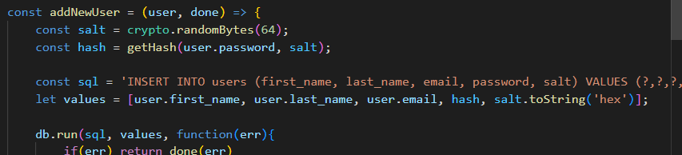
Create an account: POST /user
Create the salt
Convert to hash
Save to db
(using the crypto library – now part of Node, so already installed https://nodejs.org/api/crypto.html)
Private function – no need to export

Slide 21
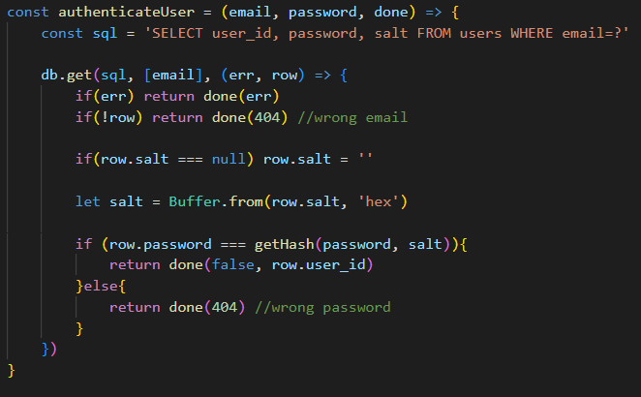
Logging in: POST /login
Function takes in the email and password from the user
Get the id, hashed password and salt from the DB
Convert the salt from hex (how its encoded)
Call the getHash password and compare with the saved hash

Slide 22
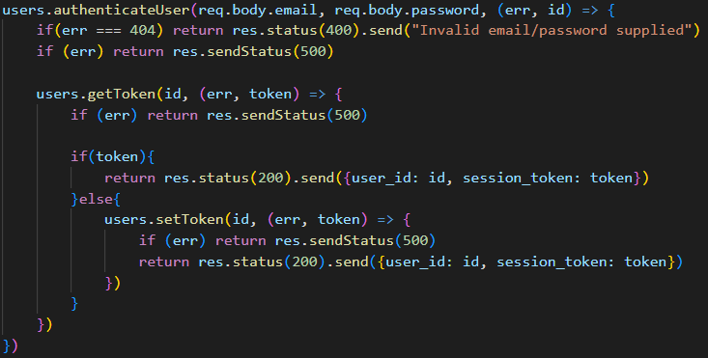
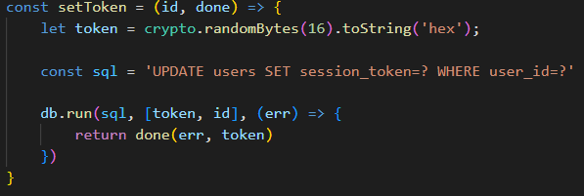
Logging in: POST /login
The users controller
But that’s not all…
If the user passes authentication, we try to get the session token from the DB (to check that the user isn’t already logged in) - getToken is a simple SELECT in the model
If no token exists, then setToken() will create a new token and save it in the DB

Slide 23
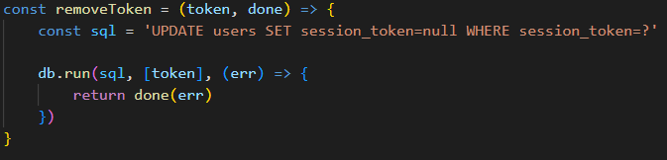
Logging out: POST /logout
When a user logs out, simply delete the token from the DB
We don’t want to delete the record, so we just update the token value to be null
Next time the user uses the token, it won't be found

Slide 24
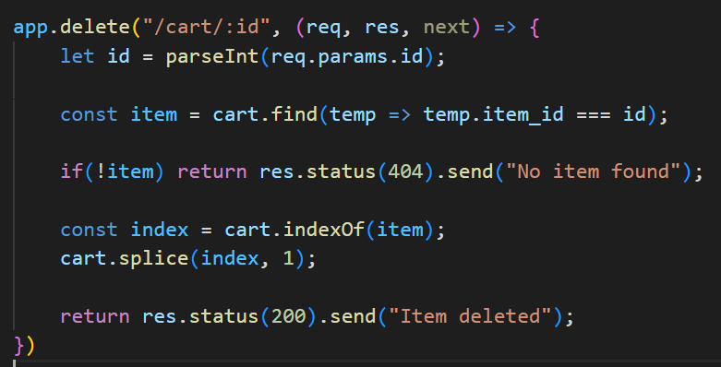
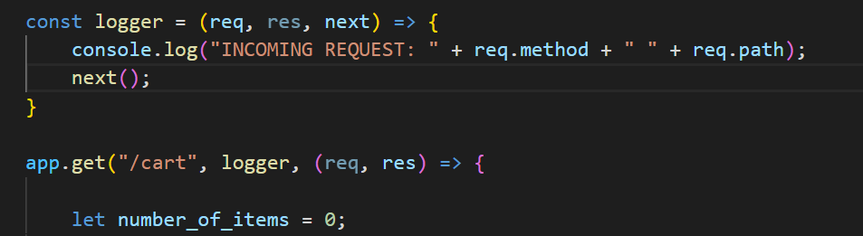
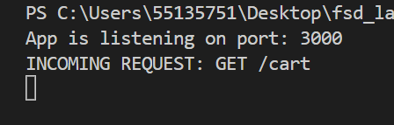
But how do we check whether they are logged in on other endpoints?
For this we can use middleware
Functions that have access to the request object (req), the response object (res), and the next() middleware function in the app’s request-response cycle (commonly named ‘next’)
  All controller functions have access to next(), but we haven’t needed to access it so far as the functions return to the client (see the greyed out next)
  But what if we create a function that sits in between to log content to the terminal?
https://expressjs.com/en/guide/using-middleware.html

Slide 25
Why use middleware?
We can chain functions together when an endpoint is hit:
  Incoming request -> validator -> logger -> check authentication -> doSomething()
  In the assignment: POST /articles -> checkAuthenticated() -> addArticle()
    Write once, use everywhere!
Middleware functions can perform the following tasks:
  Execute any code
  Make changes to the request and the response objects
  End the request-response cycle
  Call the next middleware function in the stack - If the current middleware function does not end the request-response cycle, it must call next() to pass control to the next middleware function. Otherwise, the request will be left hanging

Slide 26
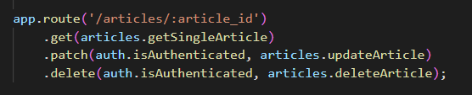
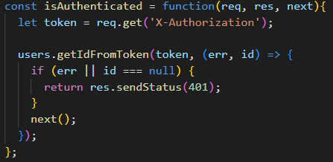

Checking authentication
Endpoints that require authentication are intercepted
Article.updateArticle() will only execute if the endpoint hasn’t already been completed by the middleware (i.e., a response returned)
The isAuthenticated() function sits in a middleware.js file in my libs directory – so that it can be pulled in by all route files
If no token or error, then return 401 unauthorised
SQL Statement in the getIdFromToken() function

Slide 27
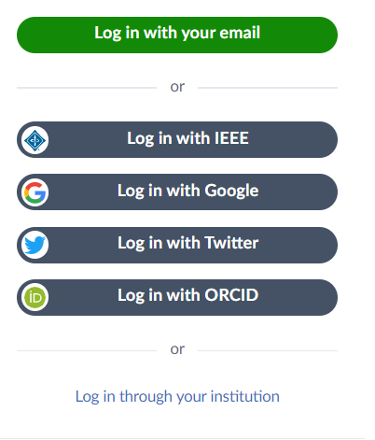
A better way of doing things?
The safest way to handle a password is to not handle a password at all…
Libraries like PassportJS allow you to implement different “strategies” for authenticating against third parties – meaning you don’t store any sensitive data
https://www.passportjs.org/
  (583 different strategies – October 2022)

Slide 28
This week’s lab
In this week's lab, you will:
  Learn how to Implement authentication as shown in the lecture
Assignment Checklist:
  Implement the four user management end-points

Slide 29
Questions?

